Slide 1
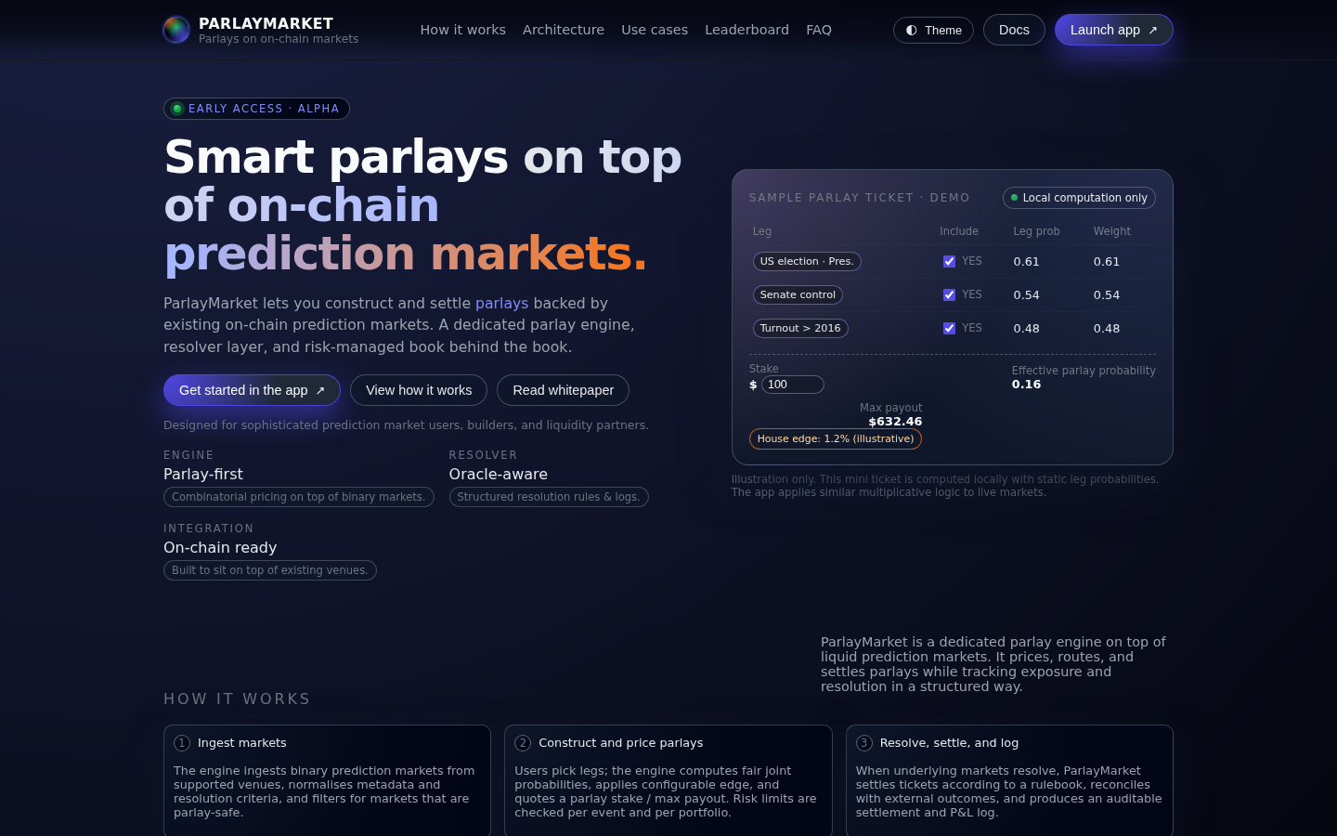
PARLAYMARKET
Parlays for prediction
markets on Polymarket
liquidity.
Multi-leg tickets as a first-class object.
Transparent payout math. Non-custodial routing.
● EARLY ACCESS · ALPHA
parlaymarket.io

Slide 2
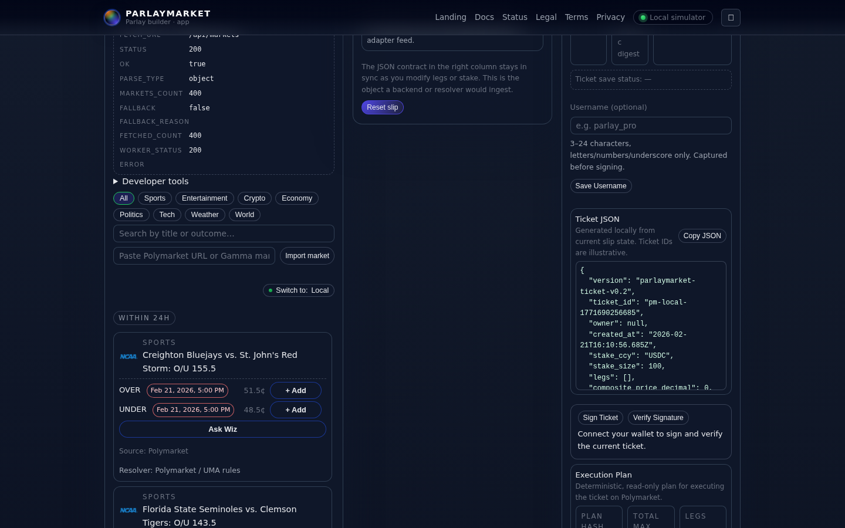
THE PROBLEM
Conditional theses are
hard to express.
Fragmented positions
Correlated bets on election sweeps or macro events require manual sizing across separate markets.
No combined pricing
Users can't see joint probability, composite odds, or max payout for a multi-leg thesis in one place.
Markets are atomic — no native parlay support
Tracking friction
Reconciling P&L across independent positions is error-prone and time-consuming.

Slide 3
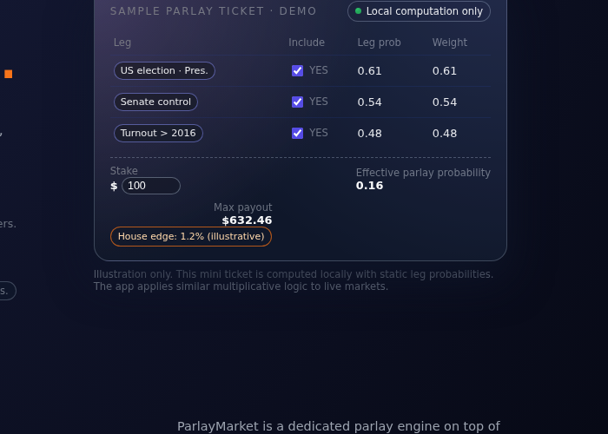
THE SOLUTION
The multi-leg ticket
as a first-class object.
Parlay-first engine
Pick legs from live markets; engine computes composite odds, implied probability, and max payout.
Transparent math
Multiplicative pricing under independence. Stake × composite odds = projected payout.
Deterministic payload
3 legs · $100 stake · $632 max payout · 0.16 implied prob
Ticket JSON schema (v0.2) with locked prices and wallet signature via WalletConnect.
Non-custodial routing
Orders route to Polymarket. ParlayMarket never holds funds or takes the other side.

Slide 4
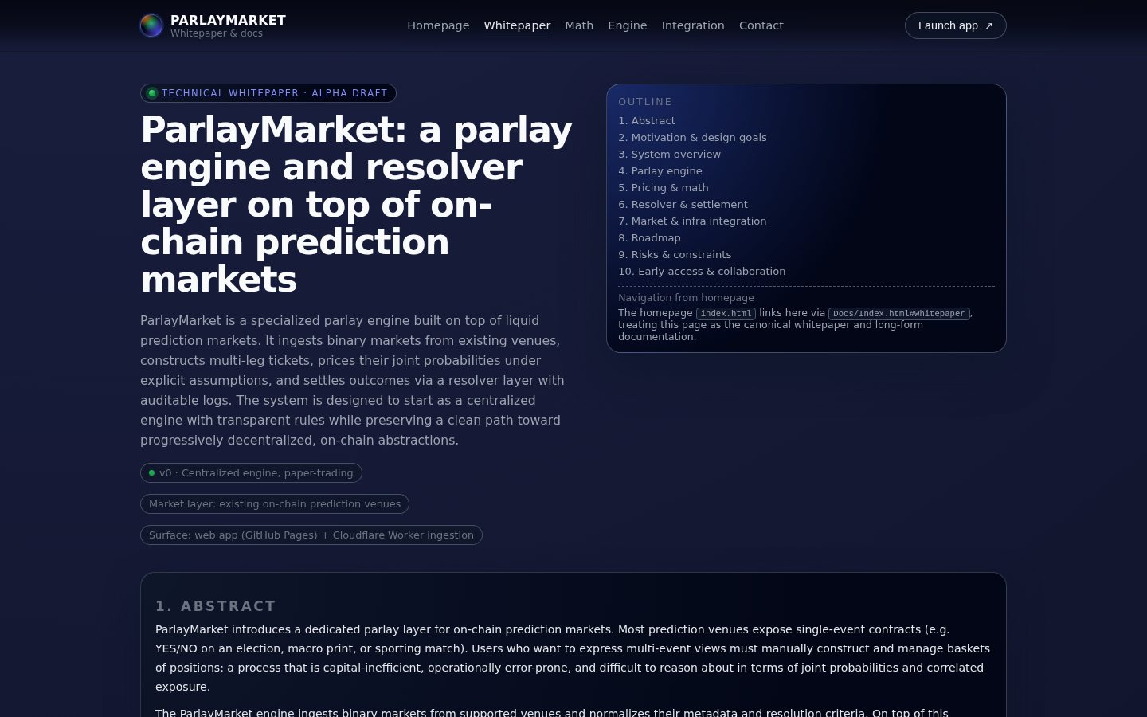
HOW IT WORKS
From market ingestion to gated execution.
1
2
3
4
5
→
→
→
→
Ingest
Markets
Select
Legs
Build
Ticket
Sign
Gated
Execution
Polymarket via
Gamma proxy
User picks
outcomes
JSON schema
v0.2
WalletConnect
signature
Canary path
defined
Full technical whitepaper at parlaymarket.io/Docs

Slide 5
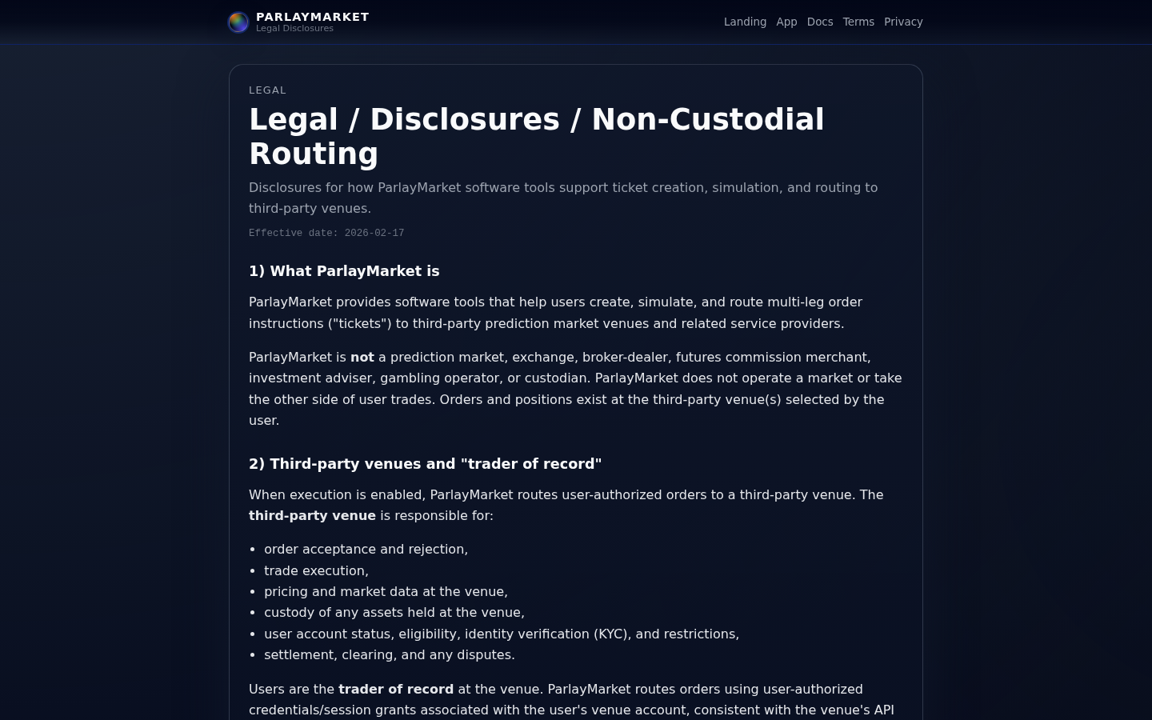
BUILDER ALIGNMENT
Route through Polymarket.
Don't fragment liquidity.
Liquidity-preserving
All orders execute on Polymarket's CLOB. ParlayMarket is a UX layer, not a competing venue.
Builder / relayer compatible
Ticket execution designed for relayer attribution and builder-grant eligibility.
Legal disclosures: parlaymarket.io/legal
Extensible architecture
Supports plugging in additional on-chain prediction venues without rebuilding core logic.
Non-custodial posture
Not a prediction market, exchange, or custodian. Positions exist at the venue.

Slide 6
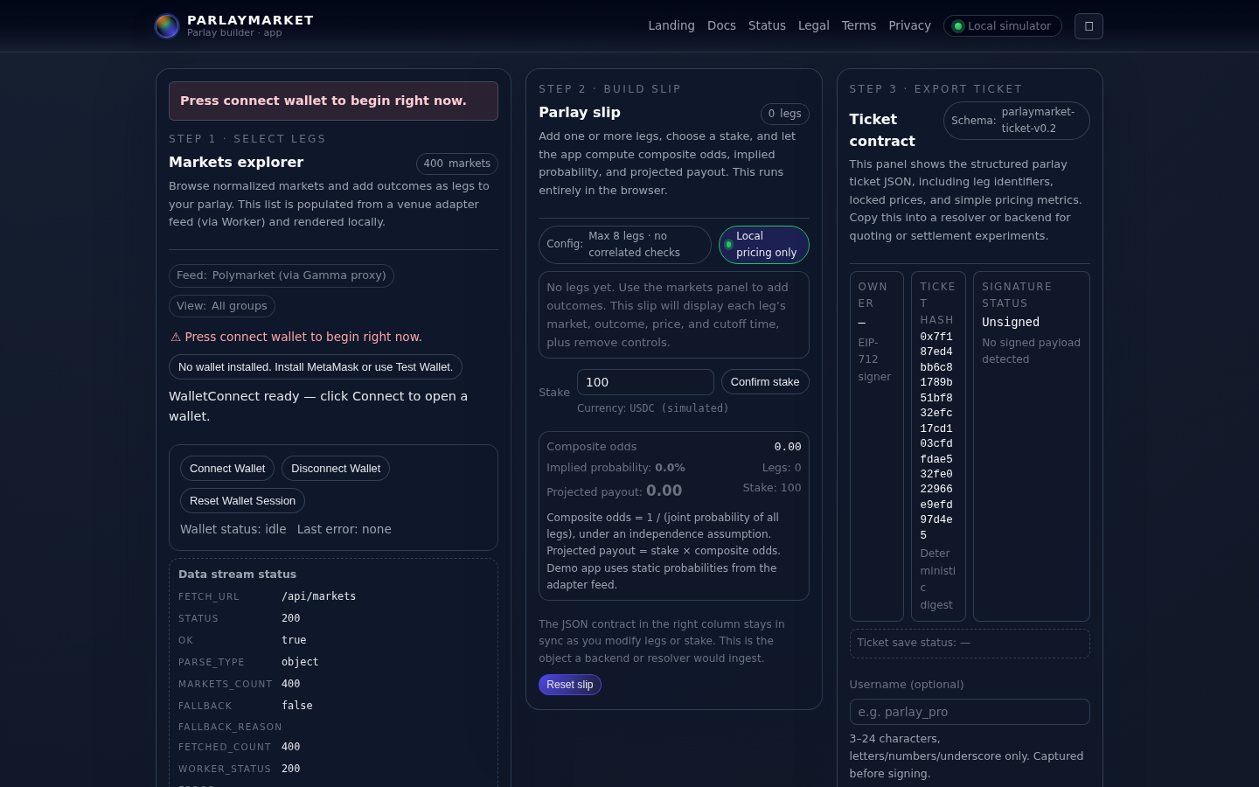
PROGRESS
Demo live. Execution gated.
Infra hardened.
App
Live — paper-trading mode
Market Feed
400 markets via Gamma proxy
Execution
Live app: parlaymarket.io/App
Gated — canary path defined
Infra
Recency sorting · cached variants · stable endpoints

Slide 7
CANARY PLAN
Safety-first path to production execution.
PHASE 1
PHASE 2
PHASE 3
Allowlist
Expand
Production
→
→
~5 wallets
Capped stakes
Idempotency checks
Receipts + logs
Kill switch tested
Slippage guards
Open execution
Builder attribution
Full audit trail
Week 1–2
Week 3–4
Week 5+
No compliance claims. Execution subject to venue rules and user authorization.

Slide 8
THE ASK
Builders grant to accelerate
demo → canary → production.
01
02
03
Integration
Ops Hardening
Canary Execution
Builder-API integration with Polymarket CLOB for production order routing and attribution.
Monitoring, rate limits, slippage guards, and kill-switch infrastructure for safe canary rollout.
Two-week allowlisted canary with capped stakes, receipts, and deterministic execution plans.
parlaymarket.io | parlaymarket.io/App | parlaymarket.io/Docs

